Slide 1
The Power of sidhistory and DCShadow!
Don Perez
Adam Steed

Slide 2

About: Don Perez
17 years of experience in IAM, working for financial, education, and healthcare organizations
Manager Protiviti Security and Privacy Practice Identity and Access Management
Don.Perez@Protiviti.com
Find Me On Linkedin

Slide 3
Agenda
Credential Theft Basics
sIDHistory
DCShadow
DCShadow and sIDHistory Combined
Detecting DCShadow and sIDHistory
Preventing Credential Theft

Slide 4
According to the 2018 Verizon Data Breach Report 3 Out Of 4 Data Theft Vectors Are IAM Related
Use of Stolen Credentials
Ram Scraper (Malware)
Phishing (Social Engineering)
Privilege Abuse

Slide 5

SIDHIStory

Slide 6
Active Directory migrations

Slide 7
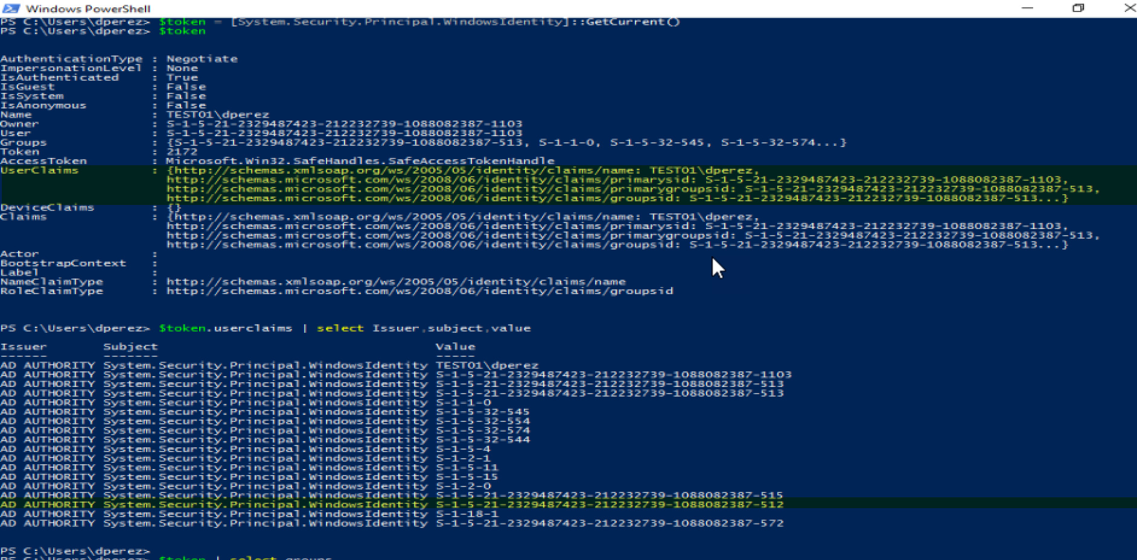
What is SIDHistory?
It is a multivalued attribute in AD.
It is also stored in the Kerberos token.
It grants access to resources.
Notes:
A security identifier (SID) is a unique value of variable length used to identify a trustee. Each account has a unique SID issued by an authority, such as a Windows domain controller, and stored in a security database. Each time a user logs on, the system retrieves the SID for that user from the database and places it in the access token for that user. The system uses the SID in the access token to identify the user in all subsequent interactions with Windows security. When a SID has been used as the unique identifier for a user or group, it cannot ever be used again to identify another user or group.
Contains previous SIDs used for the object if the object was moved from another domain. Whenever an object is moved from one domain to another, a new SID is created and that new SID becomes the objectSID. The previous SID is added to the sIDHistory property.

Slide 8

dcshadow

Slide 9
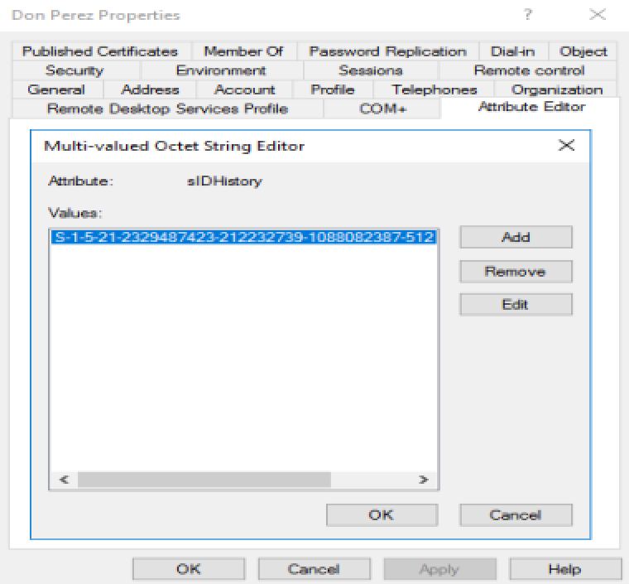
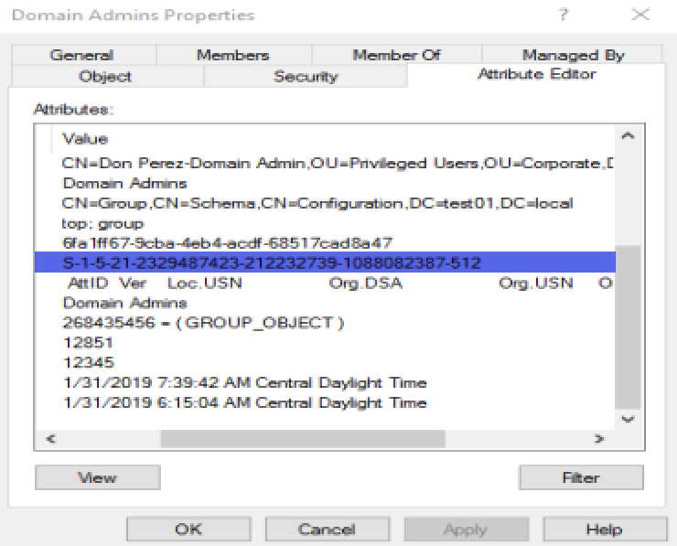
Logging into a dc without special permissions

Slide 10
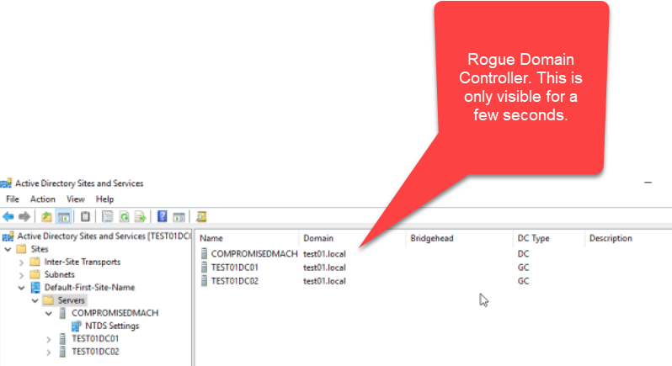
Dcshadow rogue dc
This was validated.

Slide 11
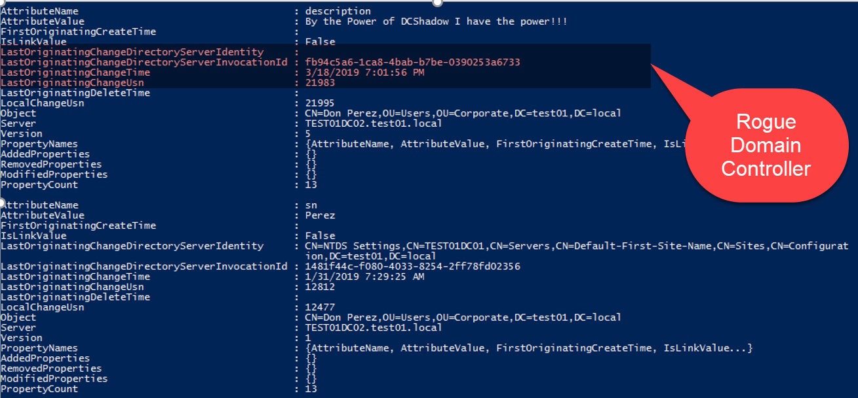
Changes found by using POwershell
Get-ADReplicationAttributeMetadata -object "CN=Don Perez,OU=Users,OU=Corporate,DC=test01,DC=local" -Server test01dc02

Slide 12
Questions

